Slide 1
Managing Unacceptable Employee Behavior
Desyra Highsmith
Director, Talent Management

Slide 2

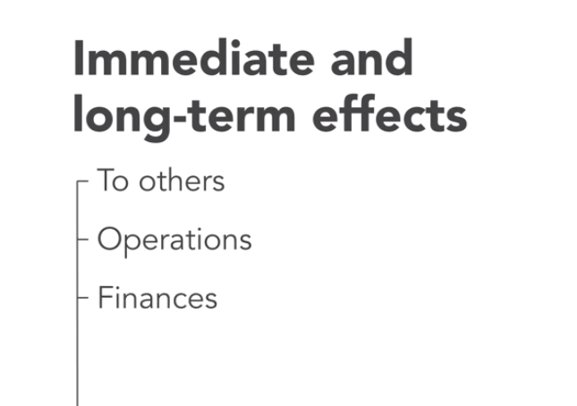
Employee Behavior Problems Cause:

Slide 3
Managing performance: the “what”
MANAGING BEHAVIOR ….the “how”

Slide 4
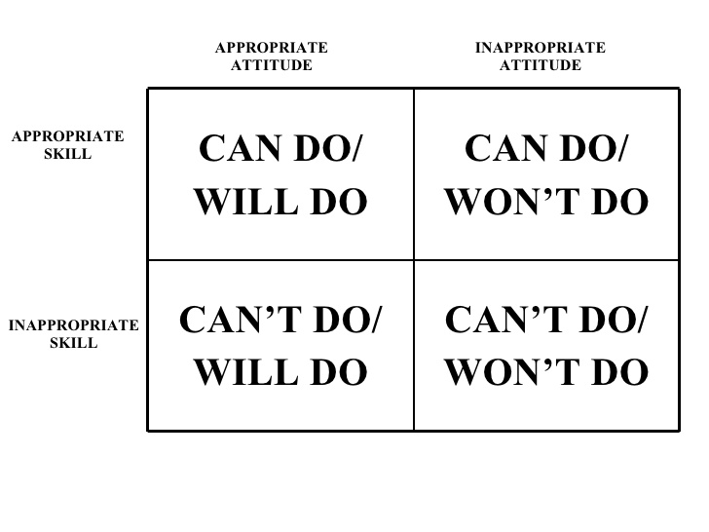
Is it a SKILL or WILL Issue?

Slide 5
BUILD A CADENCE OF
ACCOUNTABILITY

Slide 6
How to Build a Culture of Accountability
CONSISTENCY
“The What” “The How”
Tact
Concern
Authentic
Model and articulate
Demonstrate and expect it
Talk straight
Demonstrate respect
Create transparency
Clarify expectations
Practice accountability

Slide 7
4 Steps to Addressing Behavior Issues
Observe
Provide feedback
Document
Follow-up
Notes:
.

Slide 8
Addressing Behavior Issues
Corrective action should be used to correct inappropriate behavior not to punish employees.
The goal is to administer the lowest level of discipline possible in order to correct the problem, so that the same conduct will not be repeated.
The difference between addressing inappropriate conduct vs. performance is that behavior is within an employee’s ability to control.
Notes:
Before formally documenting an employee, ask yourself: “Have you counseled the colleague before either verbally or in writing?”
“If so when?” “What is the severity of the behavior?”
As a manager, you should address inappropriate behavior immediately using an appropriate level of corrective or disciplinary action. Corrective action should be used to correct inappropriate behavior not to punish. The goal is to administer the lowest level of discipline possible in order to correct the problem, so that the same conduct will not be repeated. For the purposes of the following discussion, the term "disciplinary action" refers to any formal action taken to correct behavior or conduct. It assumes for less serious offenses that you have attempted to correct the problem through coaching and feedback. The difference between addressing issues of behavior is that these are actions which are entirely within an employee’s ability to control.

Slide 9

IT NEVER HAPPENED
No documentation?
No communication!
Time and attendance reports
Examples of work product
Email exchanges
Weekly or monthly reports
Metrics related to productivity, quality or service
Suggestions, ideas or actions to make workflow efficient
Coaching agreements
Verbal or written compliments or complaints
PIPs
Evaluations
Records of adherence to and violations of policies and procedures
Conversations

Slide 10
Best Practices for
Documentation:
KEEP RECORDS:
Written/electronic
UPDATE EXPECTATIONS
Check goals for relevancy
Positive and corrective
Facts
Direct and indirect manager feedback
Record completion of results and behavior
Discuss changes in expectations

Slide 11
Documenting a Tardiness Issue
In July, an action plan was put into place to resolve the tardiness issue. That plan has not been followed as evidenced by many recent dates of being 10-20 minutes late. Most recently, these dates have been observed:
12/15- 9:15am, 12/19- 9:20am, 12/20-9:15 am, 12/21-9:20am, 1/10-9:20am 1/12 9:15 am, 1/13 (Discussion with EE) 1/17 – 9:18am, 1/20- called in late, 1/23-9:15, 1/24-9:20. 1/31 – called in late, 2/15 – 9:24 am, 2/22-9:15

Slide 12
Documenting a Conduct Issue
April 15th Conversation: On April 5th, addressed issue of a student complaint that their calls and e-mails regarding their account issue were not returned until April 15th. The departmental practice and commitment to respond to critical student inquiries within 24 hours was reviewed with EE. EE apologized for what she stated was an accidental oversight.
May 2nd: Received a complaint escalated to me regarding EE’s failure to provide student correct information regarding their program start date. As a result, the student missed the program orientation. E-mails were provided to confirm that the student was given the incorrect information by the EE. During this discussion, it was determined that EE did not refer to the updated calendar provided to all department employees in the April 3oth meeting. Employee was coached and reminded of quality, accuracy and service standards of the department.

Slide 13
Confirmation of Discussion – Simple Follow Up E-mail
Dear Buela,
I am hopeful that our meeting today was valuable as a strong reminder of our commitment to providing students with exceptional service, defined by; prompt replies (within 24 hours on weekdays) , accuracy, pleasant and positive disposition, high quality engagements in which their needs are addressed and a commitment to an outstanding experience while at William Paterson University.
I was encouraged by your expressed commitment to these departmental values and to provide service in the manner described above.
Please feel free to let me know if you encounter any challenges with which you need further guidance.

Slide 14
When further action is needed

Slide 15
Corrective Action
Cyclical Employee
Will Issue?
Conduct or Performance?
Investigate/Observe
Determine Correction Action / Clarify Expectations
Document — Written Warning
Stop! Behavior-related
Coach/Discuss
Develop & Job-related
Discuss & Document
Coaching Plan (PIP)

Slide 16
Documentation
Written Warning
Specify infraction
PIP – Performance Improvement Plan
To be used only after significant and documented coaching has occurred
Include documentation/examples
Outline previous steps to address issue
Describe impact
Stress what success looks like
Allot enough time to meet performance objectives, usually 30-60 days
Employee signature acknowledges receipt not necessarily agreement

Slide 17

EAP
Suggest vs. Administrative Referral

Slide 18
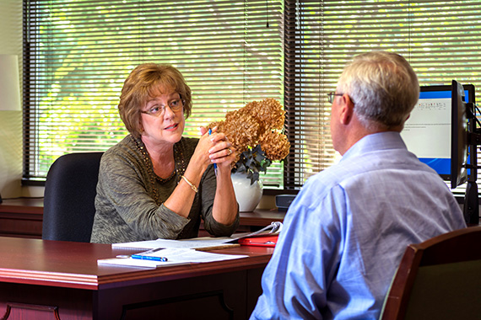


CONVERSATION ROLE PLAY

Slide 19
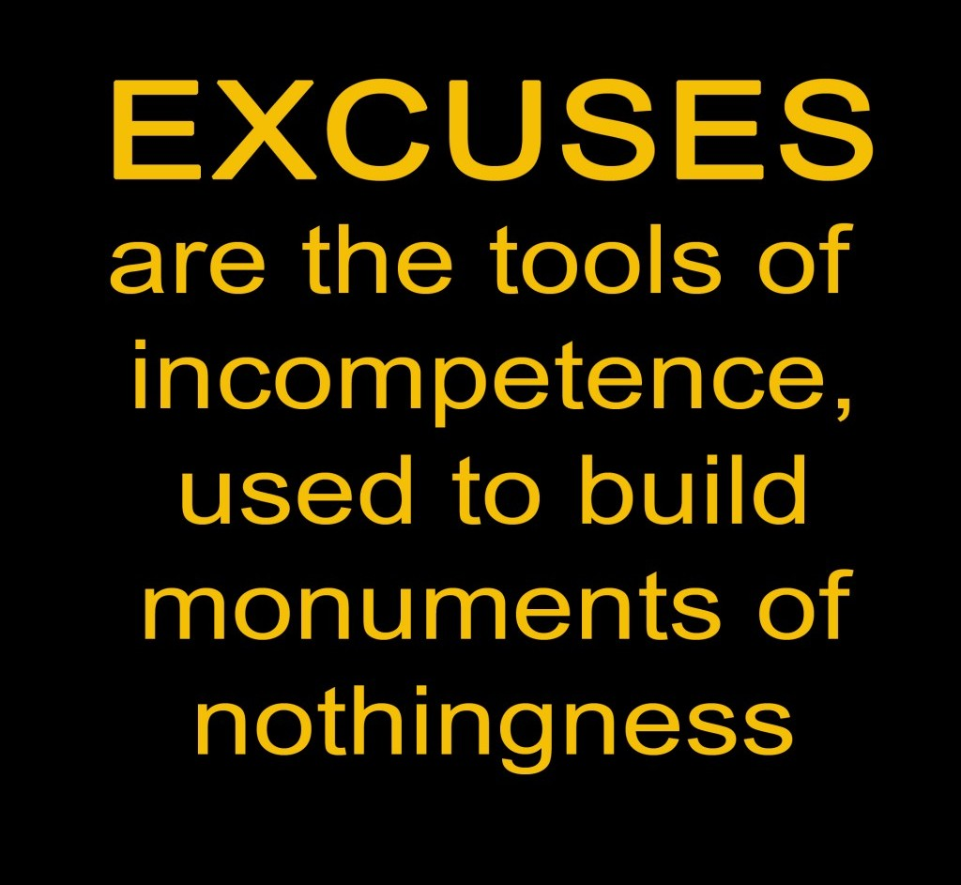
The Excuse Artist
Misses deadlines and goals but always seems ready with a good excuse or to place blame and point fingers at others.

Slide 20

DO – DISCUSS - DOCUMENT

Slide 21
DO - DISCUSS- DOCUMENT
DO Learn if it is SKILL or WILL. Is it a time management issue? Are expectations and deadlines clear? Has there been ongoing communication?
DISCUSS: I’m confused, you knew this was an important deadline. This delay prevents us from delivering on our commitment to other departments, and reflects poorly on ours. How can this be prevented from occurring in the future?
DOCUMENT: Confirmation e-mail:
I’m encouraged by the solutions discussed to prevent another missed deadline….

Slide 22
IF IT CONTINUES….....
DO. Discuss intent. Explain the problem the procrastination causes and the issues which result. Is this purposeful?
DISCUSS: Today, this is just a conversation between the two of us. "Let's consider this a clean slate. "Moving forward, I just want you to be clear "about my expectations, okay?" Which means this is not an issue unless it continues.
DOCUMENT a confirmation e-mail:
This is to confirm our discussion of…...
DOCUMENT – DISCUSS – ENGAGE HR

Slide 23

The Dawdler
A master procrastinator who can come up with plenty of excuses why a task or project hasn’t been completed. When The Dawdler gets down to business, it proceeds at a snail’s pace…stressing out team members, putting other departments behind schedule and ultimately guaranteeing missed deadlines.

Slide 24
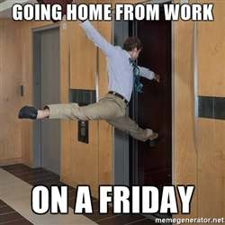
The Short Changer
Late to work, early to leave, stretched lunches, extended breaks…this person makes an art out of shortening and short-changing the workday, while leaving co-workwers “holding the bag”.

Slide 25

The Intimidator
Everyone’s tip-toeing around this person, lest they incur wrath and anger! The intimidator uses fear and bullying tactics to control coworkers and can single handedly ruin an entire team.

Slide 26

The Gossip
Behind closed doors, through the grapevine and under the radar, they’re waging verbal warfare and personal attacks, rumors and criticism are tools of the trade.

Slide 27
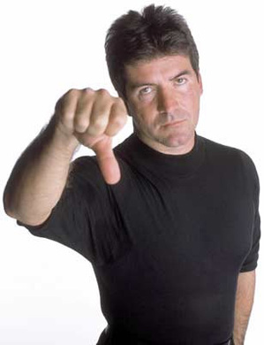
The Downer
No matter what, this person is unhappy. For this pessimist, the glass is always half empty. The Downer maintains a consistently negative, stifling presence and constantly spreads the bad news to everyone.

Slide 28

The Minimalist
Apathetic and low-performing, these unmotivated workers can be counted on to give the bare minimum(or even less). They make an art out of turning in mediocre performance…poor enough to frustrate their supervisor...but passable enough to keep them employed!

Slide 29

The Soap Star
Their continuing “soap opera” of personal problems not only hurts their own productivity, but distracts sympathetic coworkers who get drawn into their never ending predicaments and problems.

Slide 30
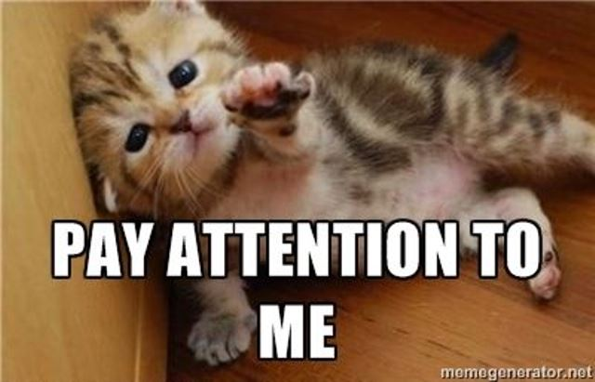
The Itch
The need constant attention, reassurance and feedback…and takes much time and energy to manage. You often find yourself sacrificing your job responsibilities to help them meet theirs.

Slide 31
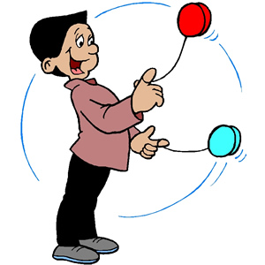
The Yo-Yo
Cyclical performer who once performed their responsibilities well. However, every now and then, performance dips. Sustained, consistent behavior and performance is the issue with this employee.

Slide 32
CONTACT YOUR HR PARTNER
Desyra Highsmith – Academic Affairs, Institutional Advancement
Denise Robinson Lewis – Student Development and Marketing/Public Relations
Veronica Ruiz –Administration & Finance and Enrollment Management

